Slide 1
Understanding Kubernetes
https://github.com/ateamsw/learn-kubernetes

Slide 2
Software Innovation Collision
Containers
(Standardization of the application packaging)
DevOps
(Optimizing how applications are build, delivered and Managed)
Microservices
(Optimizing how applications are composed)
Better Software
Kubernetes Orchestration
(Efficient ways to deliver Infrastructure for Applications)

Slide 3
Azure Overview
Notes:
There is more….
3. Power BI Desktop is a visual data exploration tool that enables you to analyze data and create stunning reports. With Power BI Desktop, you are able to:
Acquire and prepare data using extensive query capabilities.
Manipulation and consolidation of multiple data sources is performed in Power BI Desktop – this enables Power BI service users to use data from multiple sources in a single report.
Establish data structure, then transform and analyze data.
Visualize and explore your data in new ways through a freeform drag-and-drop canvas.
Author reports with a broad range of modern data visualizations.
Publish beautiful, interactive reports directly to powerbi.com.
Securely share reports through unique, curated content library approach.
4. Finally, the Power BI Platform allows you to embed, extend, and integrate Power BI into other applications and environments.

Slide 4


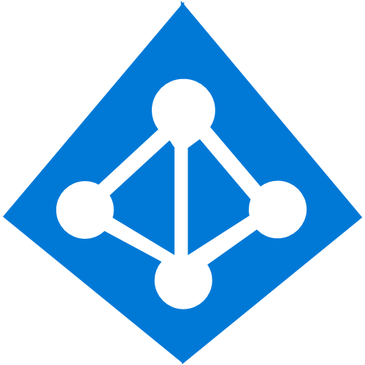

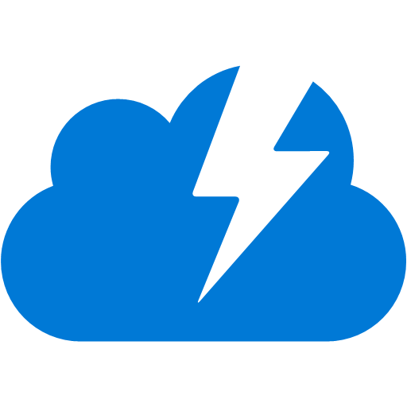








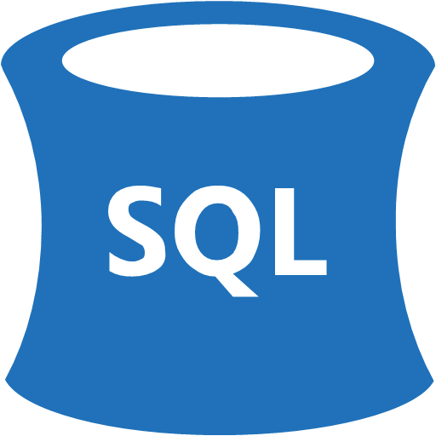


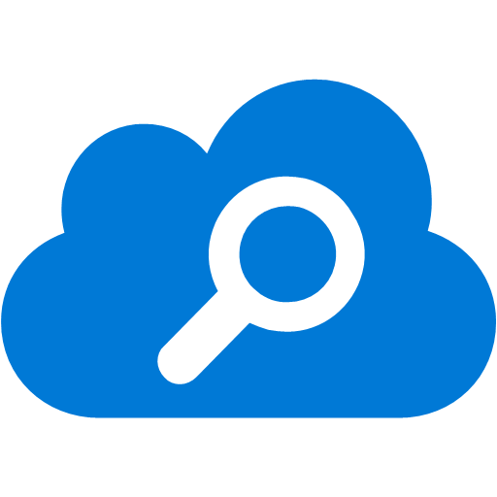
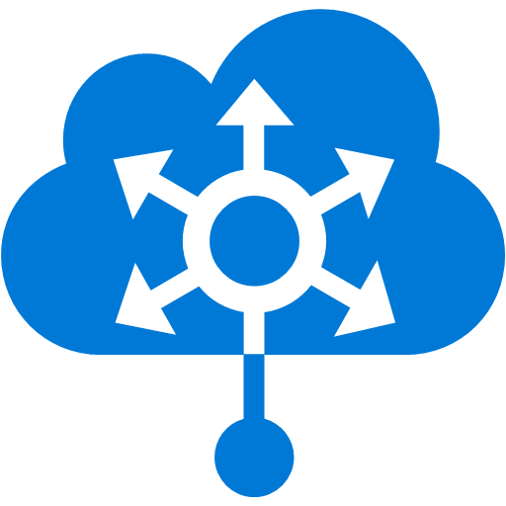
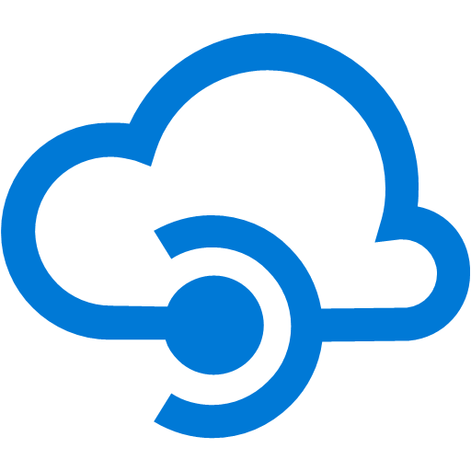




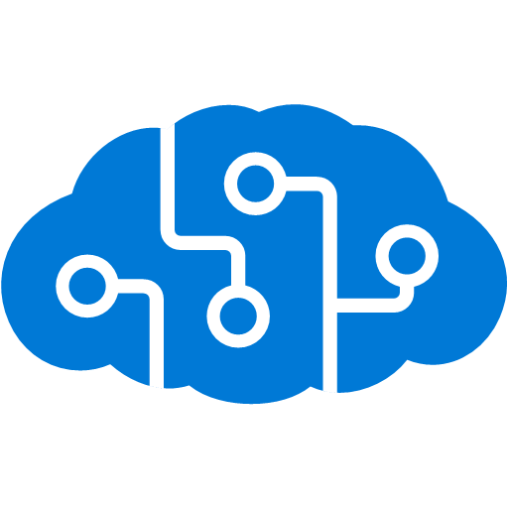


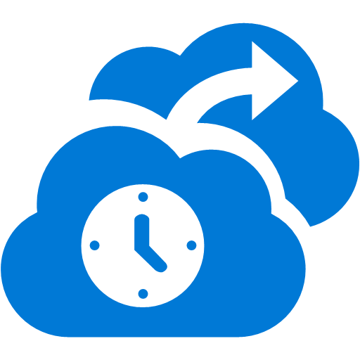
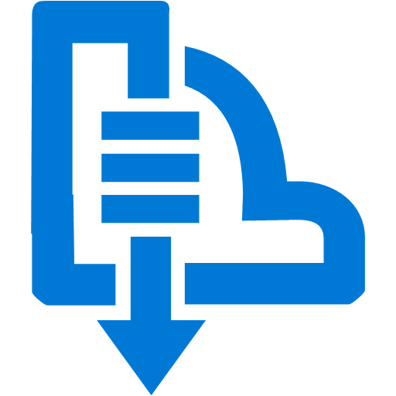


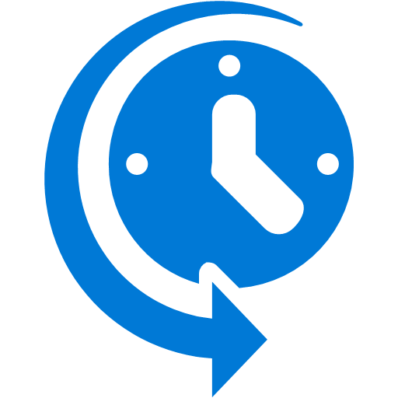



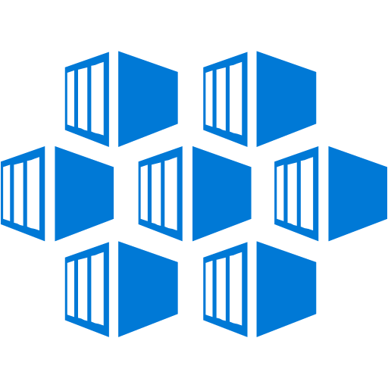

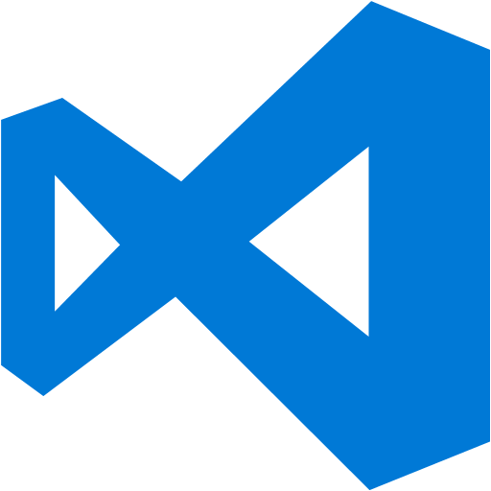


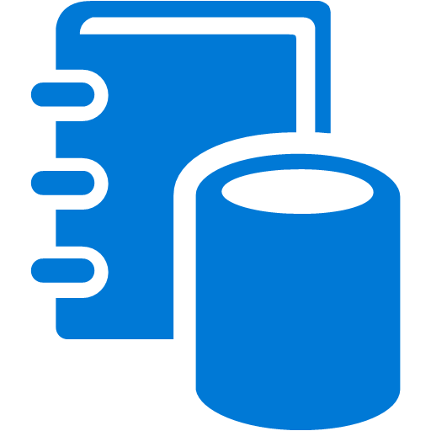

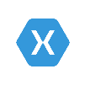
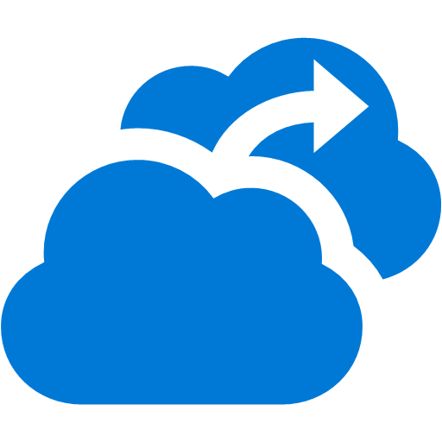




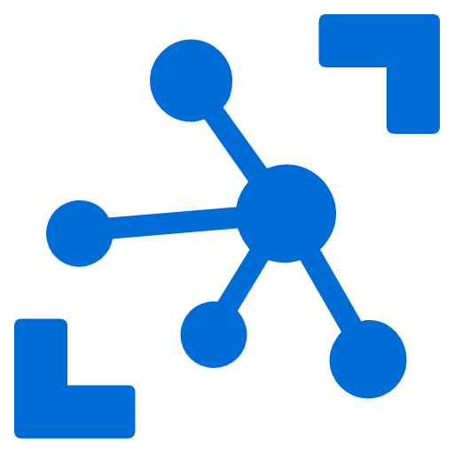
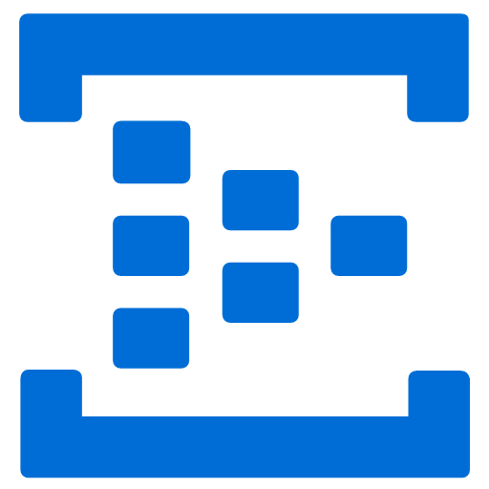



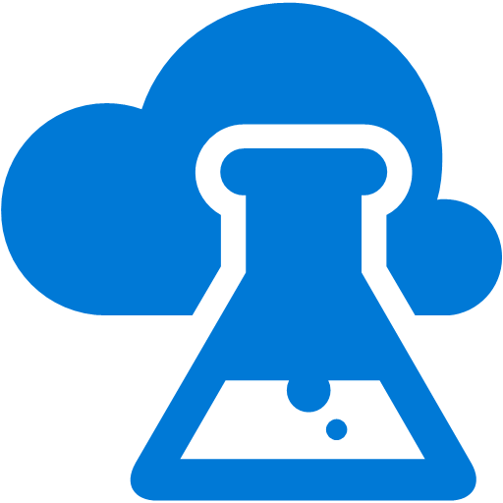
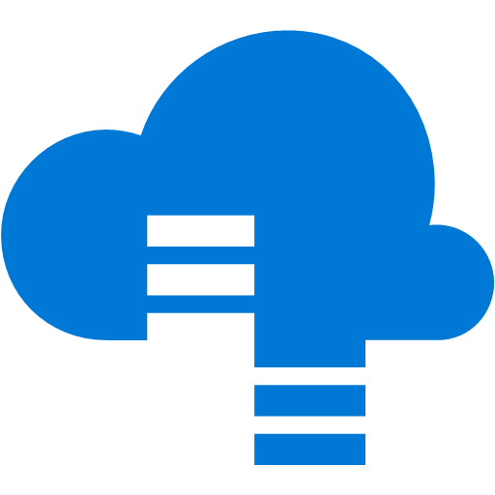


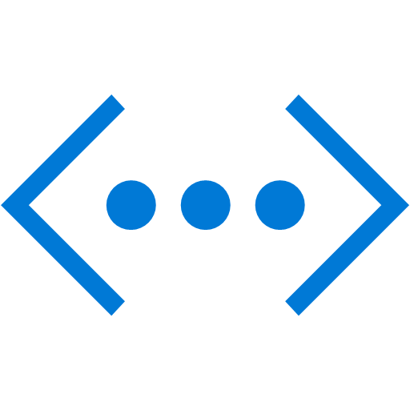
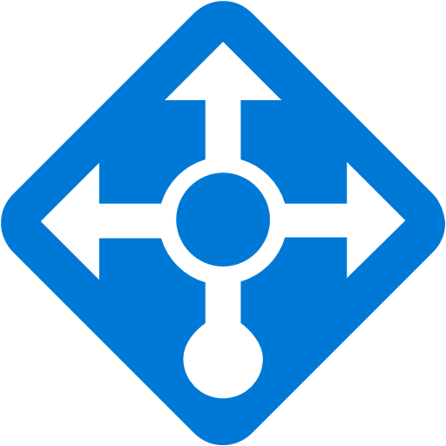

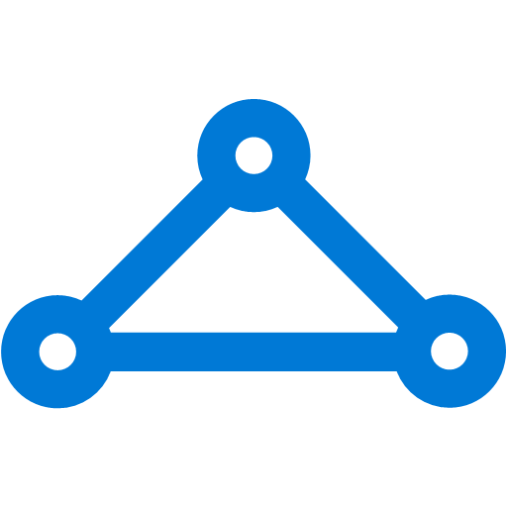

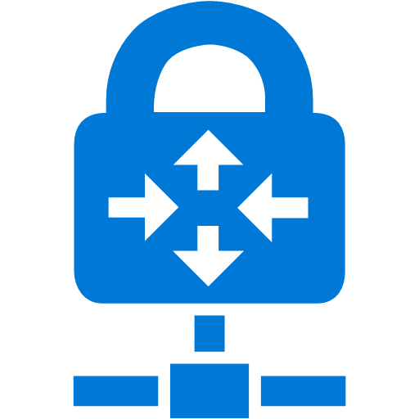

Platform Services
Security & Management
Hybrid
Cloud
Media & CDN
Application Platform
Data
Security Center
Content Delivery
Network
SQL
Database
Azure AD
Health Monitoring
Media Services
Media Analytics
Web
Apps
Mobile
Apps
SQL Data
Warehouse
CosmosDB
Portal
AD Privileged
Identity
Management
Azure Active
Directory
Integration
API
Apps
Cloud
Services
SQL Server
Stretch Database
Redis
Cache
Storage
Tables
Azure
Search
Azure AD
B2C
API
Management
BizTalk
Services
Domain Services
Service
Fabric
Notification
Hubs
Intelligence
Multi-Factor
Authentication
Logic
Apps
Service Bus
Functions
Cognitive Services
Bot Framework
Cortana
Backup
Automation
Developer Services
Analytics & IoT
Operational
Analytics
Compute Services
Scheduler
HDInsight
Machine
Learning
Stream Analytics
Container
Service
VM
Scale Sets
Visual Studio
Mobile
Engagement
Import/Export
Key Vault
Data
Catalog
Data Lake
Analytics Service
Data Lake Store
Store/
Marketplace
Batch
RemoteApp
VS Team Services
Xamarin
Azure Site
Recovery
Application
Insights
HockeyApp
IoT Hub
Event
Hubs
Data
Factory
Power BI
Embedded
VM Image Gallery
& VM Depot
Dev/Test Lab
StorSimple
Infrastructure Services
Compute
Storage
Networking
Virtual Machines
Containers
Blob
Queues
Files
Disks
Virtual Network
Load Balancer
DNS
Express
Route
Traffic Manager
VPN Gateway
App
Gateway
Datacenter Infrastructure
Notes:
Why this Slide:
It shows we have a very broad platform. It about BOTH IaaS and PaaS, that these work together. It shows that we continue to lead in world class IT capabilities and that there’s really nothing missing.
Key Points:
We have already seen how the Azure Platform is IaaS + Pass – but I want you to understand that this is a huge number of capabilities – IT building blocks if you will.
Every one of these blocks you provision anytime, self-service anywhere in the world 24x7. You pay for what you use, you can get more or less anytime and you can fully automate everything…
DON’T spent too much time on this slide – you are going to DEMO (aren’t you!!!)… DON’T go through each block…
Transition to NEXT Slide: Make the build go backwards to show JUST IaaS and then you will go to the demo to show it.

Slide 5
Application maturity model
On-Premises
Infrastructure Platform
IaaS
Infrastructure Platform
CaaS
Container Platform
PaaS
Application Platform
FaaS
Serverless Platform
App Lift & Shift
Re-host your applications from on-premise to cloud
App Modernization
Re-architect for the cloud with PaaS and containers
Modern Apps
Transform app experiences with new cloud native services and AI
Notes:
Implication is that left-to-right increases the level of modernization
Lift and Shift
Can be first step into the cloud
Maybe redeploy to CaaS instead of PaaS
App Modernization
Rearchitecting existing applications to take advantage of higher-level services (PaaS, FaaS)
DevOps can play a bigger role
Modern Apps
Born in the cloud
Cost savings
Reduced IT resources
Reduced cloud spend

Slide 6
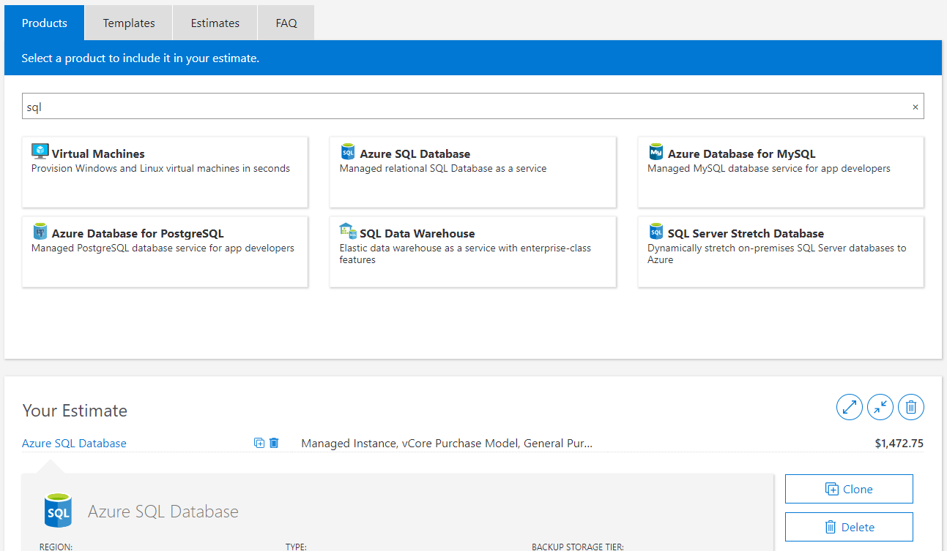
Pricing
https://azure.microsoft.com/en-us/pricing/calculator/
Notes:
Implication is that left-to-right increases the level of modernization
Lift and Shift
Can be first step into the cloud
Maybe redeploy to CaaS instead of PaaS
App Modernization
Rearchitecting existing applications to take advantage of higher-level services (PaaS, FaaS)
DevOps can play a bigger role
Modern Apps
Born in the cloud
Cost savings
Reduced IT resources
Reduced cloud spend

Slide 7
Containerization
Notes:
There is more….
3. Power BI Desktop is a visual data exploration tool that enables you to analyze data and create stunning reports. With Power BI Desktop, you are able to:
Acquire and prepare data using extensive query capabilities.
Manipulation and consolidation of multiple data sources is performed in Power BI Desktop – this enables Power BI service users to use data from multiple sources in a single report.
Establish data structure, then transform and analyze data.
Visualize and explore your data in new ways through a freeform drag-and-drop canvas.
Author reports with a broad range of modern data visualizations.
Publish beautiful, interactive reports directly to powerbi.com.
Securely share reports through unique, curated content library approach.
4. Finally, the Power BI Platform allows you to embed, extend, and integrate Power BI into other applications and environments.

Slide 8
Virtualization versus containerization?
Virtual machine
Container
Application XYZ
Application
App dependencies
Dependencies
Guest OS
Image
C
C
C
C
C
VM
VM
VM
VM
VM
VM
Dependency 1
Dependency 2
Hypervisor 2
Docker Engine
Hypervisor 1
Host OS
Host OS
Hardware
Hardware
Hardware
Type 1
Type 2
Virtualization
Containerization

Slide 9
The benefits of using containers
Agility
Ship apps faster
Portability
Easily move workloads
Density
Achieve resource efficiency
Rapid scale
Scale easily to meet demand

Slide 10


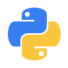

The benefits of using containers
Any OS
Anywhere
Any app
Any language
Java
Linux
On-premises
Monolith
.Net
Python
Windows
Cloud
Microservice
Node

Slide 11
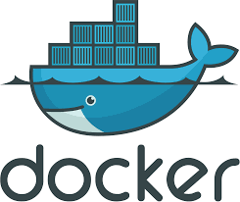
Docker
Docker is a computer program that performs operating-system-level virtualization, also known as "containerization". It was first released in 2013 and is developed by Docker, Inc.
Docker is used to run software packages called "containers". In a typical example use case, one container runs a web server and web application, while a second container runs a database server that is used by the web application.
Launched in March 2013
Over 100 million+ Downloads
Over 75K+ Docker-ized applications
100+ Case Studies worldwide
https://en.wikipedia.org/wiki/Docker_(software)

Slide 12
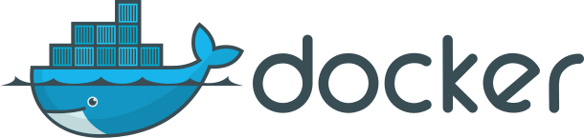
What is ?
An open source container runtime
Mac, Windows and Linux support
# Worlds simplest Dockerfile
$ cat Dockerfile
FROM scratch
COPY hello /
CMD ["/hello"]
# Create a docker image named hello-world and tagged latest
$ docker build –t hello-world:latest .
# And run it…
$ docker run hello-world:latest

Slide 13
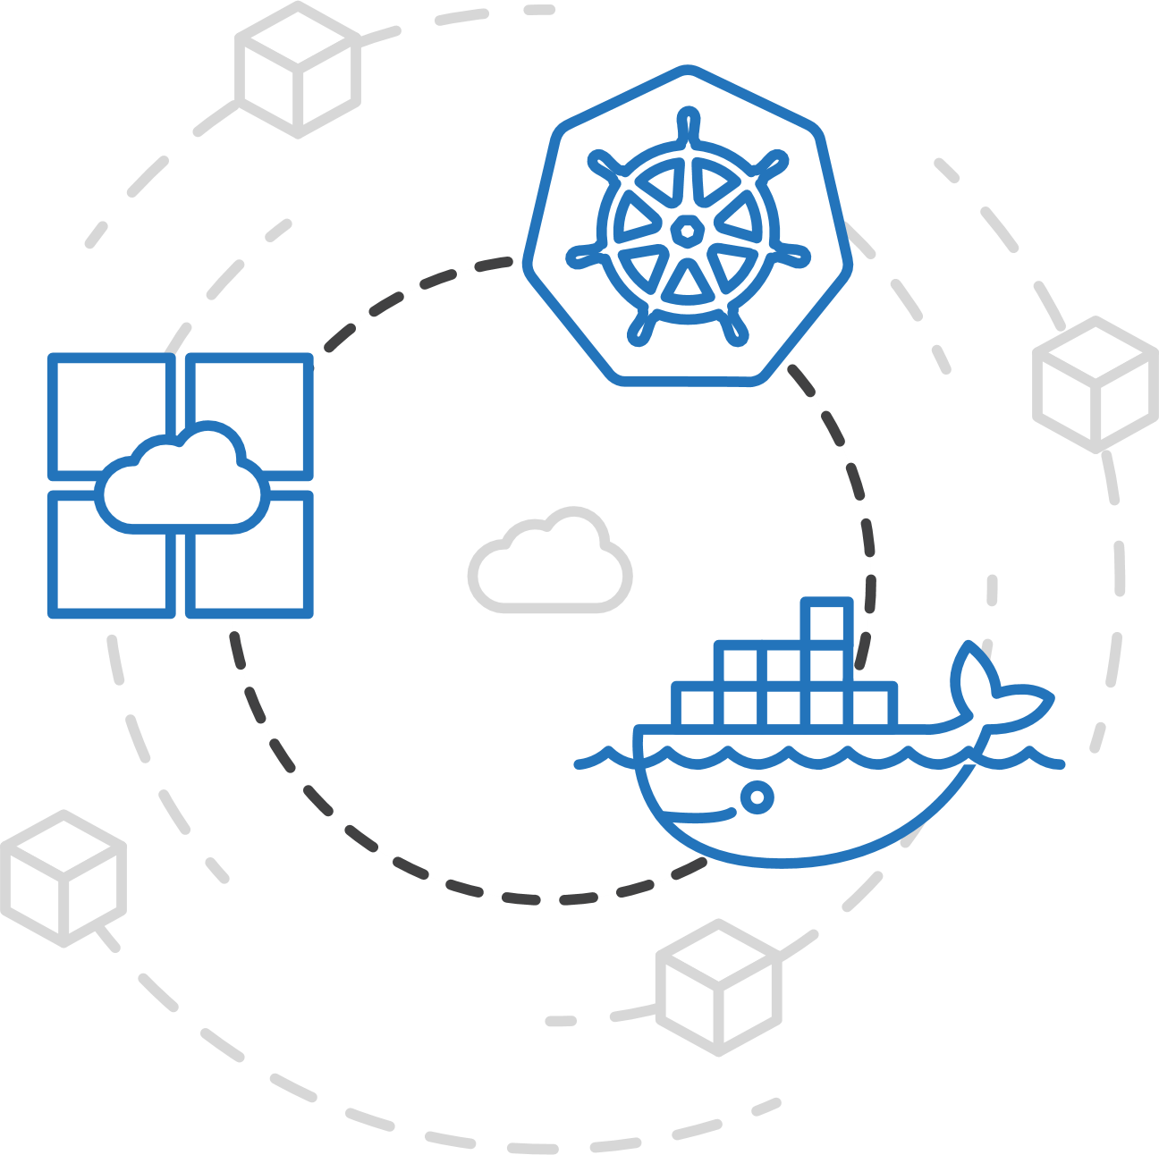
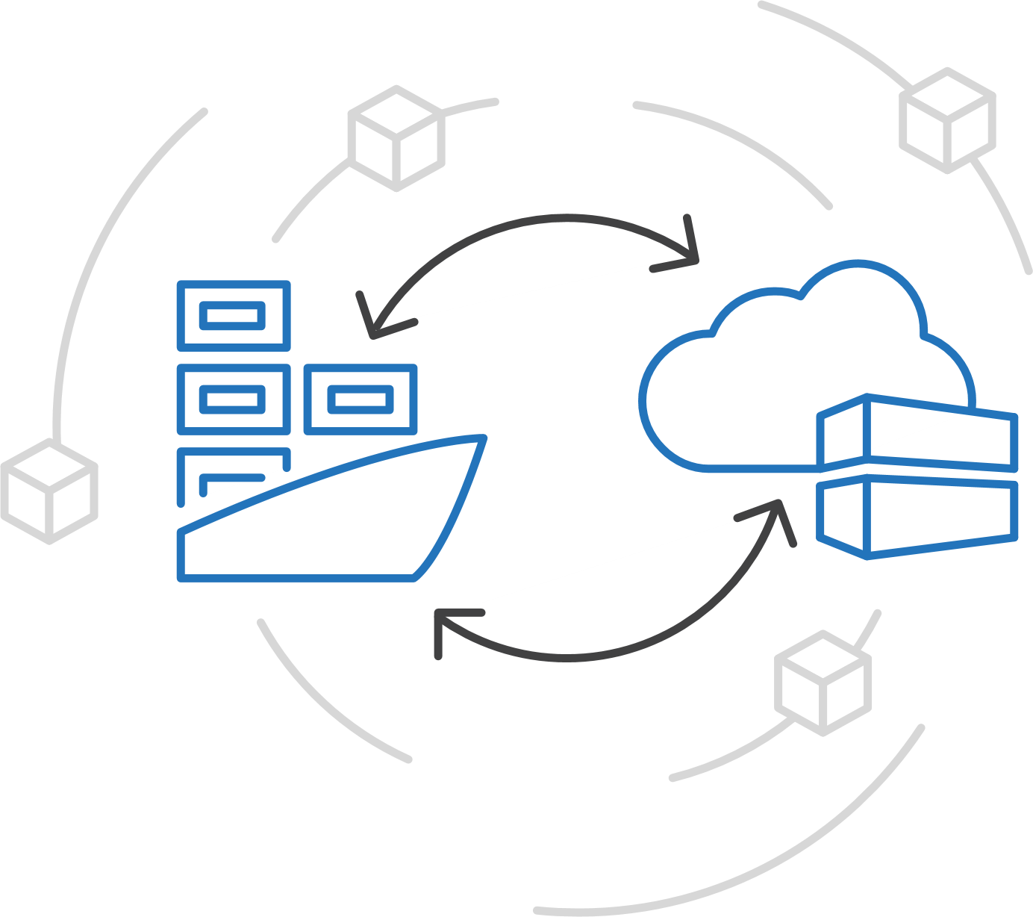
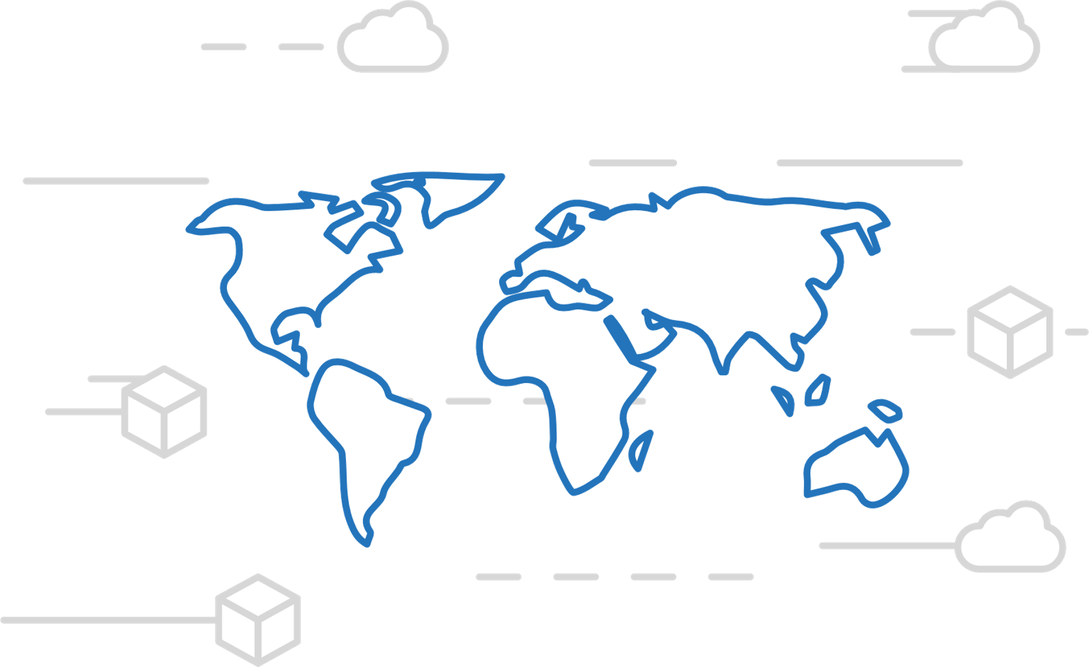
Azure Container Registry
Manage a Docker private registry as a first-class Azure resource
Manage images for all types of containers
Use familiar, open-source Docker CLI tools
Azure Container Registry geo-replication

Slide 14
Kubernetes / AKS
Notes:
There is more….
3. Power BI Desktop is a visual data exploration tool that enables you to analyze data and create stunning reports. With Power BI Desktop, you are able to:
Acquire and prepare data using extensive query capabilities.
Manipulation and consolidation of multiple data sources is performed in Power BI Desktop – this enables Power BI service users to use data from multiple sources in a single report.
Establish data structure, then transform and analyze data.
Visualize and explore your data in new ways through a freeform drag-and-drop canvas.
Author reports with a broad range of modern data visualizations.
Publish beautiful, interactive reports directly to powerbi.com.
Securely share reports through unique, curated content library approach.
4. Finally, the Power BI Platform allows you to embed, extend, and integrate Power BI into other applications and environments.

Slide 15
Kubernetes: the industry leading orchestrator
Portable
Public, private, hybrid, multi-cloud
Extensible
Modular, pluggable, hookable, composable
Self-healing
Auto-placement, auto-restart, auto-replication, auto-scaling
Notes:
Why did Kubernetes win?
Until about 18 months ago, the container orchestration space was competitive
Docker Swarm, Mesosphere DC/OS, and Kubernetes (among others) were vying for share
The original Azure Container Service reflected this market dynamic, with the choice of orchestrator
Kubernetes began to pull away around the end of 2016
Now, all cloud providers offer a managed Kubernetes service and even Docker and DC/OS integrate Kubernetes
Why?
Community: the project was donated to an OSS foundation (the Cloud Native Computing Foundation) very early on and other major players (notably Red Hat) got involved early, separating it from its Google roots and avoiding lock-in concerns
Container-native: some orchestrators (namely DC/OS) added containers to an existing scheduling technology, which is more flexible but can feel ‘tacked-on’
Built from best practices learned at scale: Kubernetes was inspired by Google’s internal scheduler Borg and incorporated the learnings from it. Other projects (especially Swarm) did not have that maturity.
Why Kubernetes won doesn’t actually matter
Its network effects are now so strong that competitors are struggling to stay relevant even if they are objectively ‘better’ in some respects

Slide 16
How AKS works
Azure managed control plane
API Server
etcd store
Master Node(s) – self managed
Automated upgrades, patches
High reliability and availability
Easy and secure cluster scaling
Self-healing
API server monitoring
Control plane at no charge
User
App/workload definition
Kubernetes API endpoint
Scheduler
Controller Mgr
Cloud Controller
Schedule pods over private tunnel
Customer VMs
Docker
Docker
Docker
Docker
Notes:
A Kubernetes cluster is typically made up of
Master nodes for system components like the API server, etcd store, and scheduler
Agent nodes for user container workloads
Managing the cluster involves:
Monitoring the API server
Ensuring HA/DR for the etcd store
Safely managing upgrades across Kubernetes versions
Safely scaling the cluster in and out
Patching master and agent VM nodes
And on and on…
This is complex, error-prone, and expensive
A managed service like AKS moves those tasks to the cloud provider

Slide 17
Kubernetes Walk Through
1.) Terminology and Overview
2.) Setting up a Cluster
3.) Working with your Cluster
4.) Deploying Workloads to Kubernetes
5.) Scalability
6.) Advanced Topics

Slide 18

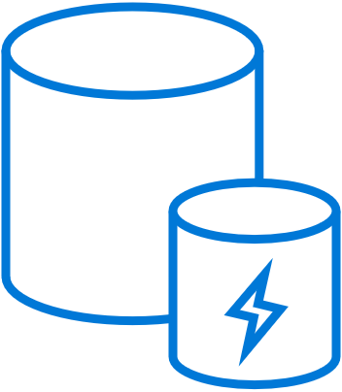
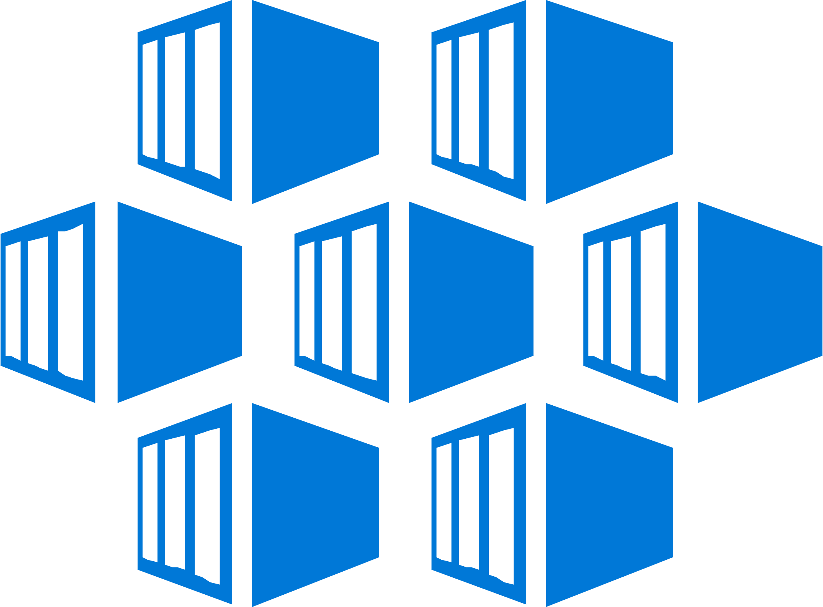
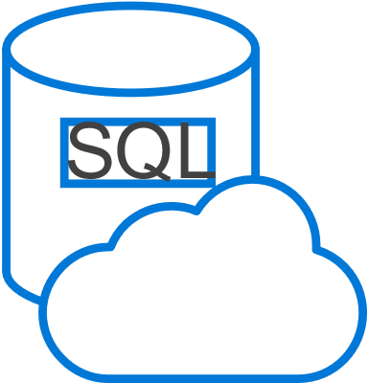
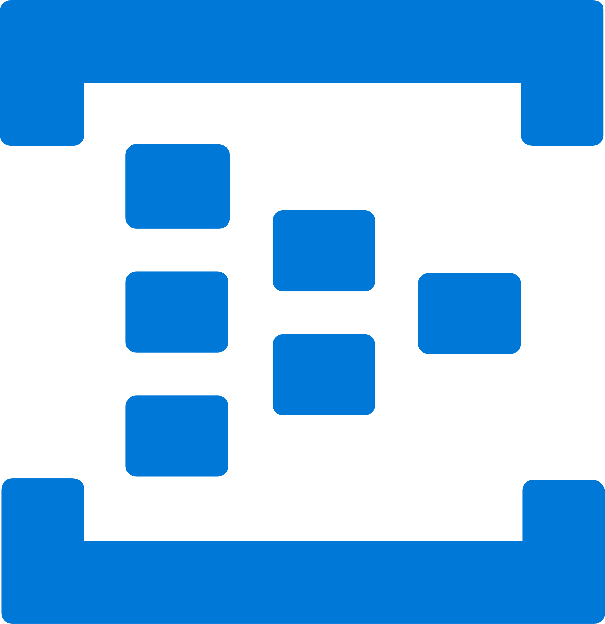




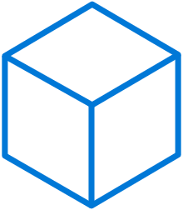
Work how you want with opensource tools and APIs
Easily connect to SLA-backed Azure services with OSBA
CosmosDB
Redis Cache
Open Source Broker for Azure (OSBA)
SQL Database
Event Hubs
Azure Database
for MySQL
Service Bus
Azure Kubernetes Service
Azure Database
for PosgreSQL
Azure Storage

